Slide 1

Designing the national HPC and public cloud-based solutions for the data-driven animal behavior detection
Haftom Hailu
Discussion and question session with Surf
Oct 10, 2023

Slide 2






Backend
Local database :
Application specific-functionalities
User management
Roles and permissions
User activity tracking
Frontend
(Spring boot, Flask)
MySQL
CouchDB REST API
Shared centralized database
Task management
Task tracking
HPC
CouchDB
Server
Container images
PiCas Client
(Pilot Job)
PiCas framework

Slide 3
Step 1: Token creation
Token structure
lock: timestamp in seconds, integer
done: timestamp in seconds, integer
type: string
hostname: string
scrub_count: integer
input: dictionary
output: dictionary

Slide 4
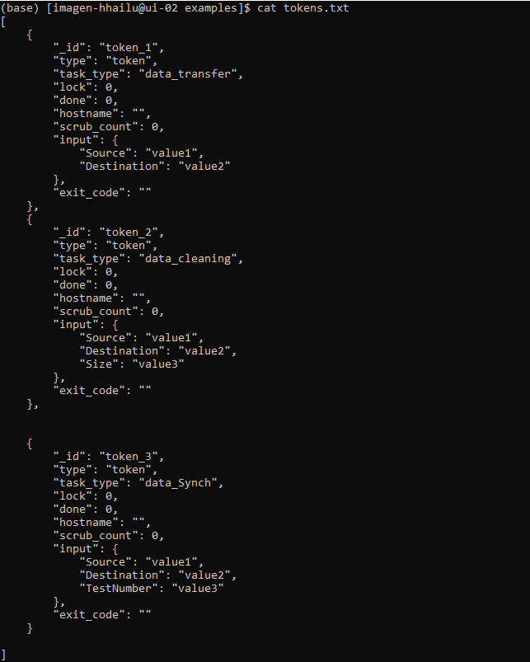
tokens.txt
Step 1: Token creation
Token structure
lock: timestamp in seconds, integer
done: timestamp in seconds, integer
type: string
hostname: string
scrub_count: integer
input: dictionary
output: dictionary

Slide 5
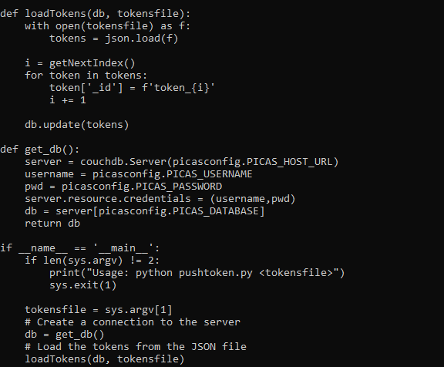

Step 2: Push token to db
uploadTokens.py

Slide 6
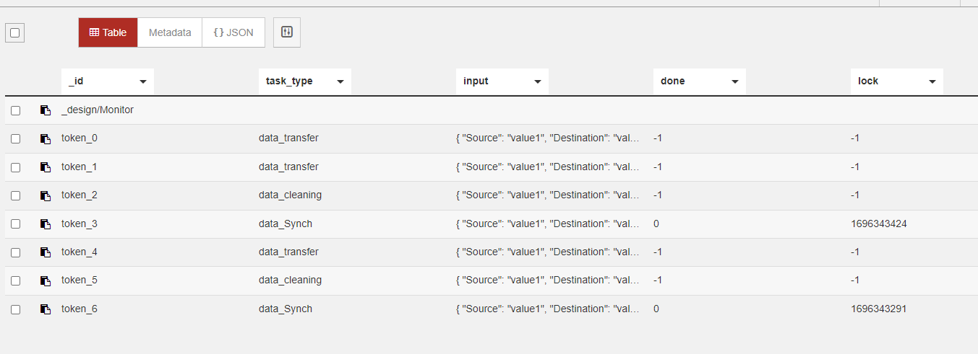
Step 2: Push token to db

Slide 7

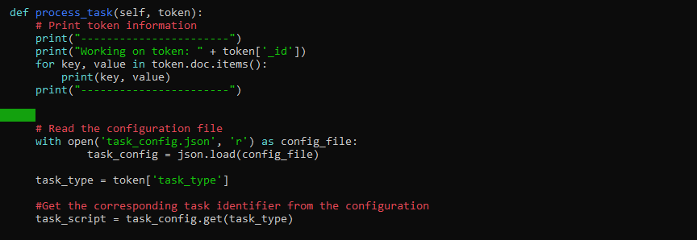
Step 3: Pilot job
task_config

Slide 8
How does pilot job interact with HPC?
Is pilot job submitted to the HPC scheduler (Slurm) as a regular job?
How often do we submit pilot job? Who submits pilot job? Admin?
For how long does the pilot job runs on worker node?
How do we handle if many users are submitting jobs from the UI, but the pilot job is not running?
Is there a way to automate pilot job submission?
Using UI?
Automated submission of pilot job at system startup?
Can we have different tables in CouchDB?

Slide 9
Meeting notes
We submit pilot jobs to HPC as normal jobs, and pilot job runs in HPC worker nodes
A user (admin) should monitor pilot job submission
We can automate pilot job submission(maybe later)
Maybe based on user activity (job submission from UI)
At regular time interval (cron, crontab)
It can be possible to use slurmAPI to monitor pilot jobs from UI(for Admin)
We should know first users of the system, what script or image they provide, the required parameters for the task
We can have different databases in couchDB based on number of users and other factors (we can have imagen_ComputerVision, imagen_AIResearcher……)
Action Points
To understand user of the system
To first develop the complete pipeline for a task. For instance, for data cleaning or yolo

